Slide 1
Classification: Probabilistic Generative Model
Notes:
Classification: Probabilistic Generative Model 分类：概率生成模型
Credit Scoring 信用评分
Input: income, savings, profession, age, past financial history …… 输入：收入，储蓄，职业，年龄，过去的财务历史......
Output: accept or refuse 输出：accept或refuse
Medical Diagnosis 医学诊断
Input: current symptoms, age, gender, past medical history …… 输入：当前症状，年龄，性别，既往病史......
Output: which kind of diseases 输出：哪一类疾病
Handwritten character recognition 手写字符识别
Face recognition 人脸识别
Input: image of a face, output: person 输入：人脸图像，输出：人
Total: sum of all stats that come after this, a general guide to how strong a pokemon is 总值：在此之后的所有属性的总和，即关于pokemon的强大程度的一般指南
HP: hit points, or health, defines how much damage a pokemon can withstand before fainting HP：生命值或生命值决定了pokemon在昏厥前能够承受多少伤害
Attack: the base modifier for normal attacks (eg. Scratch, Punch) 攻击:普通攻击的基础修正值。划痕,打孔)
Defense: the base damage resistance against normal attacks 防御:抵抗普通攻击的基础伤害
SP Atk: special attack, the base modifier for special attacks (e.g. fire blast, bubble beam) SP攻击：特殊攻击，特殊攻击的基础修饰符（如火焰爆炸，气泡束）
SP Def: the base damage resistance against special attacks SP防御:对特殊攻击的基础伤害抵抗
Speed: determines which pokemon attacks first each round 速度：决定每个回合哪个口袋妖怪先攻击
Can we predict the “type” of pokemon based on the information? 我们能否根据这些信息预测pokemon的“类型”？
to decrease error 为了减少误差
Penalize to the examples that are “too correct” … 惩罚那些“太正确”的例子……
Ideal Alternatives 理想的替代品
Perceptron 感知器
Estimating the Probabilities From training data 从训练数据估计概率
Prior 先前的，事先的
Gaussian Distribution 高斯分布
Maximum Likelihood 最大似然

Slide 2
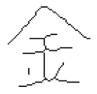

Classification
Function
$$x$$
Class n
Credit Scoring
Input: income, savings, profession, age, past financial history ……
Output: accept or refuse
Medical Diagnosis
Input: current symptoms, age, gender, past medical history ……
Output: which kind of diseases
Handwritten character recognition
Face recognition
Input: image of a face, output: person
output:
Input:
金
Notes:
Classification: Probabilistic Generative Model 分类：概率生成模型
Credit Scoring 信用评分
Input: income, savings, profession, age, past financial history …… 输入：收入，储蓄，职业，年龄，过去的财务历史......
Output: accept or refuse 输出：accept或refuse
Medical Diagnosis 医学诊断
Input: current symptoms, age, gender, past medical history …… 输入：当前症状，年龄，性别，既往病史......
Output: which kind of diseases 输出：哪一类疾病
Handwritten character recognition 手写字符识别
Face recognition 人脸识别
Input: image of a face, output: person 输入：人脸图像，输出：人
Total: sum of all stats that come after this, a general guide to how strong a pokemon is 总值：在此之后的所有属性的总和，即关于pokemon的强大程度的一般指南
HP: hit points, or health, defines how much damage a pokemon can withstand before fainting HP：生命值或生命值决定了pokemon在昏厥前能够承受多少伤害
Attack: the base modifier for normal attacks (eg. Scratch, Punch) 攻击:普通攻击的基础修正值。划痕,打孔)
Defense: the base damage resistance against normal attacks 防御:抵抗普通攻击的基础伤害
SP Atk: special attack, the base modifier for special attacks (e.g. fire blast, bubble beam) SP攻击：特殊攻击，特殊攻击的基础修饰符（如火焰爆炸，气泡束）
SP Def: the base damage resistance against special attacks SP防御:对特殊攻击的基础伤害抵抗
Speed: determines which pokemon attacks first each round 速度：决定每个回合哪个口袋妖怪先攻击
Can we predict the “type” of pokemon based on the information? 我们能否根据这些信息预测pokemon的“类型”？
to decrease error 为了减少误差
Penalize to the examples that are “too correct” … 惩罚那些“太正确”的例子……
Ideal Alternatives 理想的替代品
Perceptron 感知器
Estimating the Probabilities From training data 从训练数据估计概率
Prior 先前的，事先的
Gaussian Distribution 高斯分布
Maximum Likelihood 最大似然

Slide 3
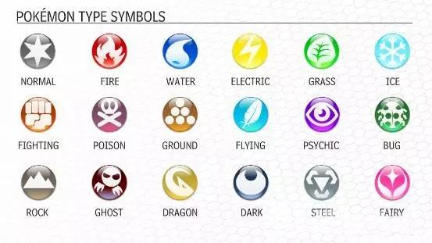









Example Application
$$f\left( \right)=$$
$$f\left( \right)=$$
$$f\left( \right)=$$
Notes:
Classification: Probabilistic Generative Model 分类：概率生成模型
Credit Scoring 信用评分
Input: income, savings, profession, age, past financial history …… 输入：收入，储蓄，职业，年龄，过去的财务历史......
Output: accept or refuse 输出：accept或refuse
Medical Diagnosis 医学诊断
Input: current symptoms, age, gender, past medical history …… 输入：当前症状，年龄，性别，既往病史......
Output: which kind of diseases 输出：哪一类疾病
Handwritten character recognition 手写字符识别
Face recognition 人脸识别
Input: image of a face, output: person 输入：人脸图像，输出：人
Total: sum of all stats that come after this, a general guide to how strong a pokemon is 总值：在此之后的所有属性的总和，即关于pokemon的强大程度的一般指南
HP: hit points, or health, defines how much damage a pokemon can withstand before fainting HP：生命值或生命值决定了pokemon在昏厥前能够承受多少伤害
Attack: the base modifier for normal attacks (eg. Scratch, Punch) 攻击:普通攻击的基础修正值。划痕,打孔)
Defense: the base damage resistance against normal attacks 防御:抵抗普通攻击的基础伤害
SP Atk: special attack, the base modifier for special attacks (e.g. fire blast, bubble beam) SP攻击：特殊攻击，特殊攻击的基础修饰符（如火焰爆炸，气泡束）
SP Def: the base damage resistance against special attacks SP防御:对特殊攻击的基础伤害抵抗
Speed: determines which pokemon attacks first each round 速度：决定每个回合哪个口袋妖怪先攻击
Can we predict the “type” of pokemon based on the information? 我们能否根据这些信息预测pokemon的“类型”？
to decrease error 为了减少误差
Penalize to the examples that are “too correct” … 惩罚那些“太正确”的例子……
Ideal Alternatives 理想的替代品
Perceptron 感知器
Estimating the Probabilities From training data 从训练数据估计概率
Prior 先前的，事先的
Gaussian Distribution 高斯分布
Maximum Likelihood 最大似然

Slide 4
Example Application
pokemon games (NOT pokemon cards or Pokemon Go)
HP: hit points, or health, defines how much damage a pokemon can withstand before fainting
Attack: the base modifier for normal attacks (eg. Scratch, Punch)
Defense: the base damage resistance against normal attacks
SP Atk: special attack, the base modifier for special attacks (e.g. fire blast, bubble beam)
SP Def: the base damage resistance against special attacks
Speed: determines which pokemon attacks first each round
35
55
40
50
50
90
Can we predict the “type” of pokemon based on the information?
Notes:
Classification: Probabilistic Generative Model 分类：概率生成模型
Credit Scoring 信用评分
Input: income, savings, profession, age, past financial history …… 输入：收入，储蓄，职业，年龄，过去的财务历史......
Output: accept or refuse 输出：accept或refuse
Medical Diagnosis 医学诊断
Input: current symptoms, age, gender, past medical history …… 输入：当前症状，年龄，性别，既往病史......
Output: which kind of diseases 输出：哪一类疾病
Handwritten character recognition 手写字符识别
Face recognition 人脸识别
Input: image of a face, output: person 输入：人脸图像，输出：人
Total: sum of all stats that come after this, a general guide to how strong a pokemon is 总值：在此之后的所有属性的总和，即关于pokemon的强大程度的一般指南
HP: hit points, or health, defines how much damage a pokemon can withstand before fainting HP：生命值或生命值决定了pokemon在昏厥前能够承受多少伤害
Attack: the base modifier for normal attacks (eg. Scratch, Punch) 攻击:普通攻击的基础修正值。划痕,打孔)
Defense: the base damage resistance against normal attacks 防御:抵抗普通攻击的基础伤害
SP Atk: special attack, the base modifier for special attacks (e.g. fire blast, bubble beam) SP攻击：特殊攻击，特殊攻击的基础修饰符（如火焰爆炸，气泡束）
SP Def: the base damage resistance against special attacks SP防御:对特殊攻击的基础伤害抵抗
Speed: determines which pokemon attacks first each round 速度：决定每个回合哪个口袋妖怪先攻击
Can we predict the “type” of pokemon based on the information? 我们能否根据这些信息预测pokemon的“类型”？
to decrease error 为了减少误差
Penalize to the examples that are “too correct” … 惩罚那些“太正确”的例子……
Ideal Alternatives 理想的替代品
Perceptron 感知器
Estimating the Probabilities From training data 从训练数据估计概率
Prior 先前的，事先的
Gaussian Distribution 高斯分布
Maximum Likelihood 最大似然

Slide 5
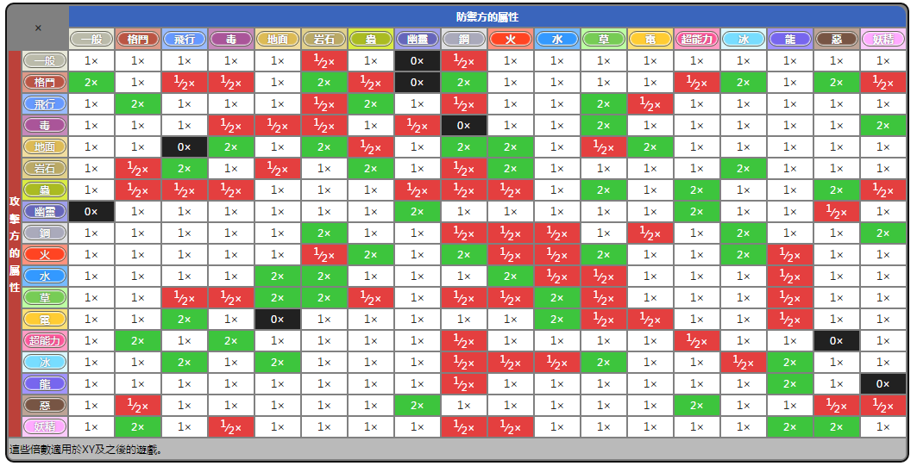
Example Application
Notes:
Classification: Probabilistic Generative Model 分类：概率生成模型
Credit Scoring 信用评分
Input: income, savings, profession, age, past financial history …… 输入：收入，储蓄，职业，年龄，过去的财务历史......
Output: accept or refuse 输出：accept或refuse
Medical Diagnosis 医学诊断
Input: current symptoms, age, gender, past medical history …… 输入：当前症状，年龄，性别，既往病史......
Output: which kind of diseases 输出：哪一类疾病
Handwritten character recognition 手写字符识别
Face recognition 人脸识别
Input: image of a face, output: person 输入：人脸图像，输出：人
Total: sum of all stats that come after this, a general guide to how strong a pokemon is 总值：在此之后的所有属性的总和，即关于pokemon的强大程度的一般指南
HP: hit points, or health, defines how much damage a pokemon can withstand before fainting HP：生命值或生命值决定了pokemon在昏厥前能够承受多少伤害
Attack: the base modifier for normal attacks (eg. Scratch, Punch) 攻击:普通攻击的基础修正值。划痕,打孔)
Defense: the base damage resistance against normal attacks 防御:抵抗普通攻击的基础伤害
SP Atk: special attack, the base modifier for special attacks (e.g. fire blast, bubble beam) SP攻击：特殊攻击，特殊攻击的基础修饰符（如火焰爆炸，气泡束）
SP Def: the base damage resistance against special attacks SP防御:对特殊攻击的基础伤害抵抗
Speed: determines which pokemon attacks first each round 速度：决定每个回合哪个口袋妖怪先攻击
Can we predict the “type” of pokemon based on the information? 我们能否根据这些信息预测pokemon的“类型”？
to decrease error 为了减少误差
Penalize to the examples that are “too correct” … 惩罚那些“太正确”的例子……
Ideal Alternatives 理想的替代品
Perceptron 感知器
Estimating the Probabilities From training data 从训练数据估计概率
Prior 先前的，事先的
Gaussian Distribution 高斯分布
Maximum Likelihood 最大似然

Slide 6

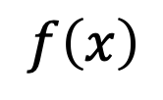
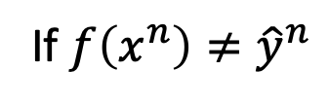
Ideal Alternatives
$$δ\left(f\left(x^{n}\right)≠{\hat{y}}^{n}\right)$$
=1
If $\left.f\left(x^{n}\right)≠{\hat{y}}^{n}\right.$
$$f\left(x\right)$$
=0
otherwise
Function (Model):
Loss function:
Find the best function:
Example: Perceptron, SVM
$$g\left(x\right)>0$$
Output = class 1
$$x$$
$$else$$
Output = class 2
$$L\left(f\right)=\sum_{n}{δ\left(f\left(x^{n}\right)≠{\hat{y}}^{n}\right)}$$
The number of times f get incorrect results on training data.
Not Today
Notes:
Classification: Probabilistic Generative Model 分类：概率生成模型
Credit Scoring 信用评分
Input: income, savings, profession, age, past financial history …… 输入：收入，储蓄，职业，年龄，过去的财务历史......
Output: accept or refuse 输出：accept或refuse
Medical Diagnosis 医学诊断
Input: current symptoms, age, gender, past medical history …… 输入：当前症状，年龄，性别，既往病史......
Output: which kind of diseases 输出：哪一类疾病
Handwritten character recognition 手写字符识别
Face recognition 人脸识别
Input: image of a face, output: person 输入：人脸图像，输出：人
Total: sum of all stats that come after this, a general guide to how strong a pokemon is 总值：在此之后的所有属性的总和，即关于pokemon的强大程度的一般指南
HP: hit points, or health, defines how much damage a pokemon can withstand before fainting HP：生命值或生命值决定了pokemon在昏厥前能够承受多少伤害
Attack: the base modifier for normal attacks (eg. Scratch, Punch) 攻击:普通攻击的基础修正值。划痕,打孔)
Defense: the base damage resistance against normal attacks 防御:抵抗普通攻击的基础伤害
SP Atk: special attack, the base modifier for special attacks (e.g. fire blast, bubble beam) SP攻击：特殊攻击，特殊攻击的基础修饰符（如火焰爆炸，气泡束）
SP Def: the base damage resistance against special attacks SP防御:对特殊攻击的基础伤害抵抗
Speed: determines which pokemon attacks first each round 速度：决定每个回合哪个口袋妖怪先攻击
Can we predict the “type” of pokemon based on the information? 我们能否根据这些信息预测pokemon的“类型”？
Ideal Alternatives 理想的替代品
Perceptron 感知器
to decrease error 为了减少误差
Penalize to the examples that are “too correct” … 惩罚那些“太正确”的例子……
Estimating the Probabilities From training data 从训练数据估计概率
Prior 先前的，事先的
Gaussian Distribution 高斯分布
Maximum Likelihood 最大似然

Slide 7




How to do Classification
Training data for Classification
$$\left(x^{1},{\hat{y}}^{1}\right)$$
$$\left(x^{2},{\hat{y}}^{2}\right)$$
$$……$$
$$\left(x^{N},{\hat{y}}^{N}\right)$$
Classification as Regression?
Binary classification as example
Training: Class 1 means the target is 1; Class 2 means the target is -1
Testing: closer to 1 $→$ class 1; closer to -1 $→$ class 2
Notes:
Classification: Probabilistic Generative Model 分类：概率生成模型
Credit Scoring 信用评分
Input: income, savings, profession, age, past financial history …… 输入：收入，储蓄，职业，年龄，过去的财务历史......
Output: accept or refuse 输出：accept或refuse
Medical Diagnosis 医学诊断
Input: current symptoms, age, gender, past medical history …… 输入：当前症状，年龄，性别，既往病史......
Output: which kind of diseases 输出：哪一类疾病
Handwritten character recognition 手写字符识别
Face recognition 人脸识别
Input: image of a face, output: person 输入：人脸图像，输出：人
Total: sum of all stats that come after this, a general guide to how strong a pokemon is 总值：在此之后的所有属性的总和，即关于pokemon的强大程度的一般指南
HP: hit points, or health, defines how much damage a pokemon can withstand before fainting HP：生命值或生命值决定了pokemon在昏厥前能够承受多少伤害
Attack: the base modifier for normal attacks (eg. Scratch, Punch) 攻击:普通攻击的基础修正值。划痕,打孔)
Defense: the base damage resistance against normal attacks 防御:抵抗普通攻击的基础伤害
SP Atk: special attack, the base modifier for special attacks (e.g. fire blast, bubble beam) SP攻击：特殊攻击，特殊攻击的基础修饰符（如火焰爆炸，气泡束）
SP Def: the base damage resistance against special attacks SP防御:对特殊攻击的基础伤害抵抗
Speed: determines which pokemon attacks first each round 速度：决定每个回合哪个口袋妖怪先攻击
Can we predict the “type” of pokemon based on the information? 我们能否根据这些信息预测pokemon的“类型”？
Ideal Alternatives 理想的替代品
Perceptron 感知器
Testing: closer to 1 $→$ class 1; closer to -1 $→$ class 2
接近 1 为第一类，接近 2 为第二类
to decrease error 为了减少误差
Penalize to the examples that are “too correct” … 惩罚那些“太正确”的例子……
Estimating the Probabilities From training data 从训练数据估计概率
Prior 先前的，事先的
Gaussian Distribution 高斯分布
Maximum Likelihood 最大似然

Slide 8
b + w₁x₁ + w₂x₂ = 0
to decrease error
Class 2
Class 2
-1
-1
Multiple class: Class 1 means the target is 1; Class 2 means the target is 2; Class 3 means the target is 3 …… problematic
1
1
x₂
x₂
Class 1
Class 1
>>1
y = b + w₁x₁ + w₂x₂
error
x₁
x₁
Penalize to the examples that are “too correct” …
(Bishop, P186)
Notes:
Classification: Probabilistic Generative Model 分类：概率生成模型
Credit Scoring 信用评分
Input: income, savings, profession, age, past financial history …… 输入：收入，储蓄，职业，年龄，过去的财务历史......
Output: accept or refuse 输出：accept或refuse
Medical Diagnosis 医学诊断
Input: current symptoms, age, gender, past medical history …… 输入：当前症状，年龄，性别，既往病史......
Output: which kind of diseases 输出：哪一类疾病
Handwritten character recognition 手写字符识别
Face recognition 人脸识别
Input: image of a face, output: person 输入：人脸图像，输出：人
Total: sum of all stats that come after this, a general guide to how strong a pokemon is 总值：在此之后的所有属性的总和，即关于pokemon的强大程度的一般指南
HP: hit points, or health, defines how much damage a pokemon can withstand before fainting HP：生命值或生命值决定了pokemon在昏厥前能够承受多少伤害
Attack: the base modifier for normal attacks (eg. Scratch, Punch) 攻击:普通攻击的基础修正值。划痕,打孔)
Defense: the base damage resistance against normal attacks 防御:抵抗普通攻击的基础伤害
SP Atk: special attack, the base modifier for special attacks (e.g. fire blast, bubble beam) SP攻击：特殊攻击，特殊攻击的基础修饰符（如火焰爆炸，气泡束）
SP Def: the base damage resistance against special attacks SP防御:对特殊攻击的基础伤害抵抗
Speed: determines which pokemon attacks first each round 速度：决定每个回合哪个口袋妖怪先攻击
Can we predict the “type” of pokemon based on the information? 我们能否根据这些信息预测pokemon的“类型”？
Ideal Alternatives 理想的替代品
Perceptron 感知器
Testing: closer to 1 $→$ class 1; closer to -1 $→$ class 2
接近 1 为第一类，接近 2 为第二类
to decrease error 为了减少误差
Penalize to the examples that are “too correct” … 惩罚那些“太正确”的例子……
Estimating the Probabilities From training data 从训练数据估计概率
Prior 先前的，事先的
Gaussian Distribution 高斯分布
Maximum Likelihood 最大似然

Slide 9
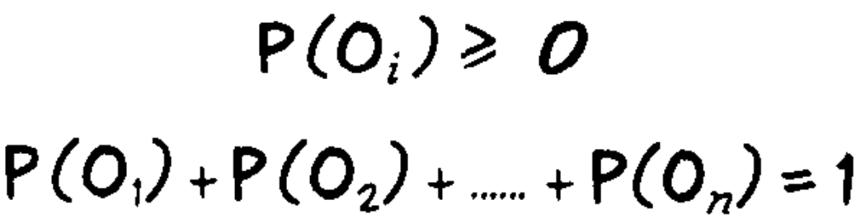
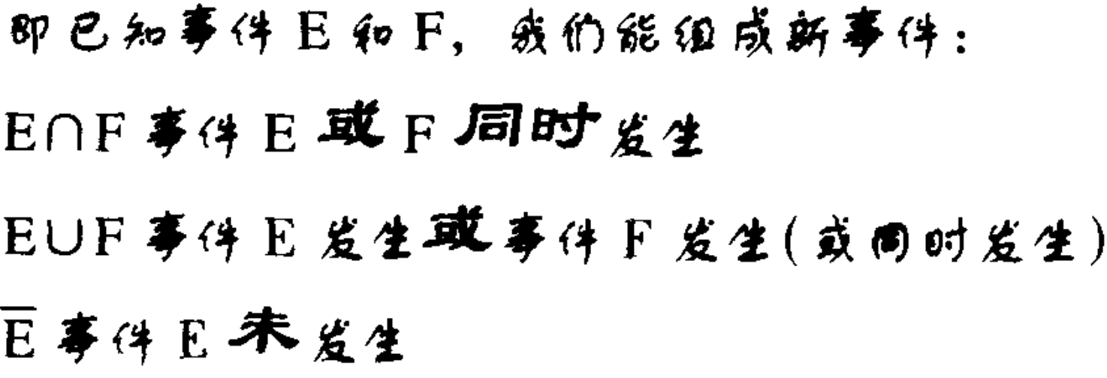

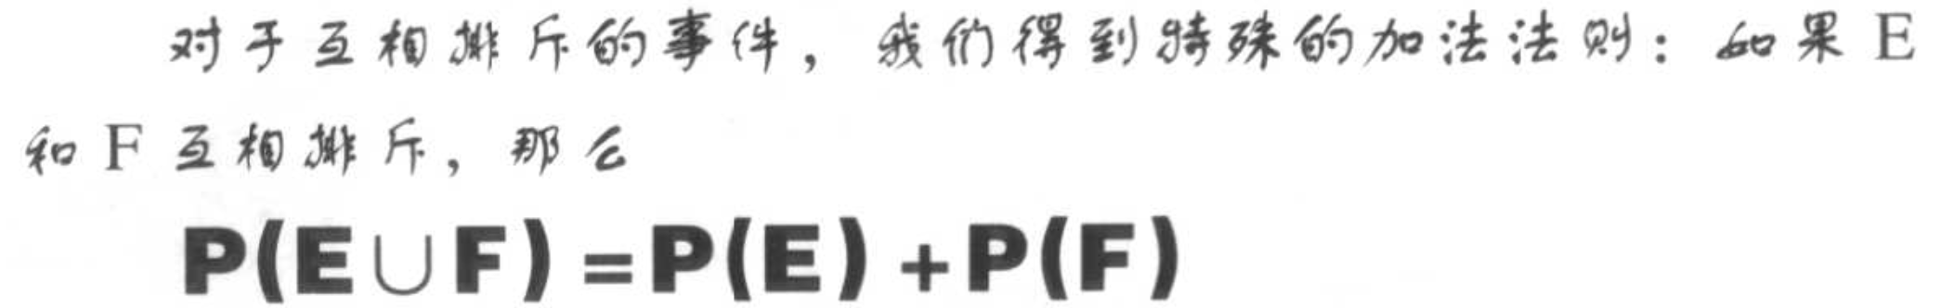
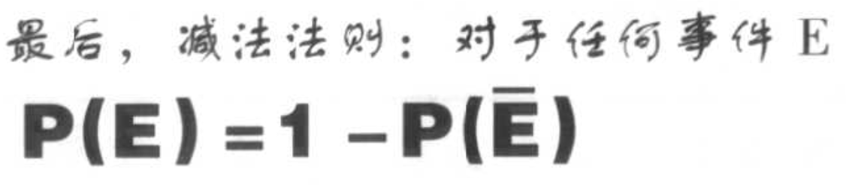

Slide 10
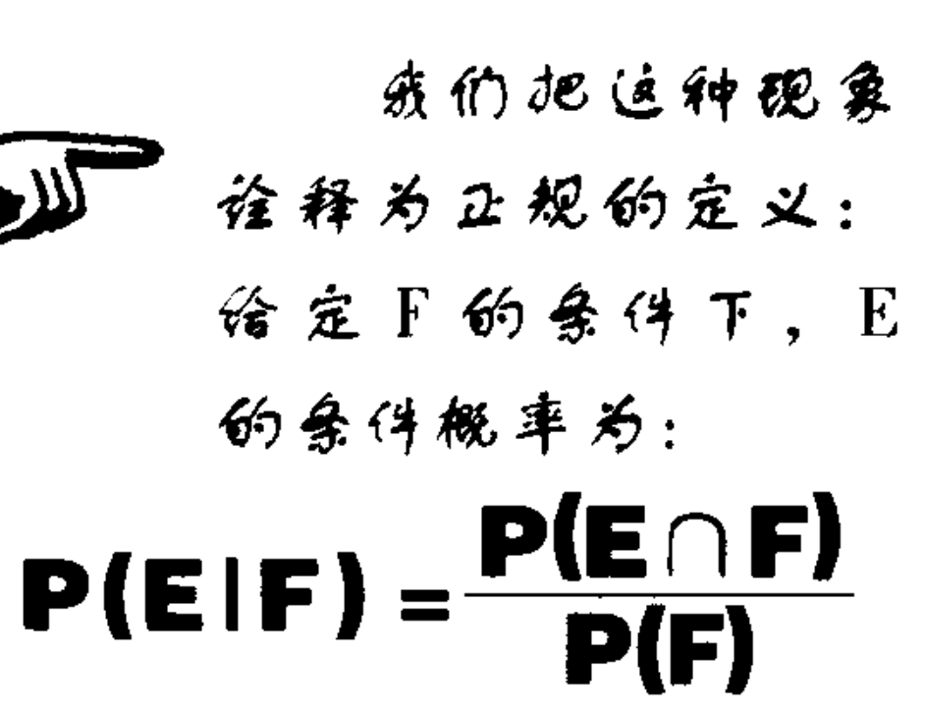
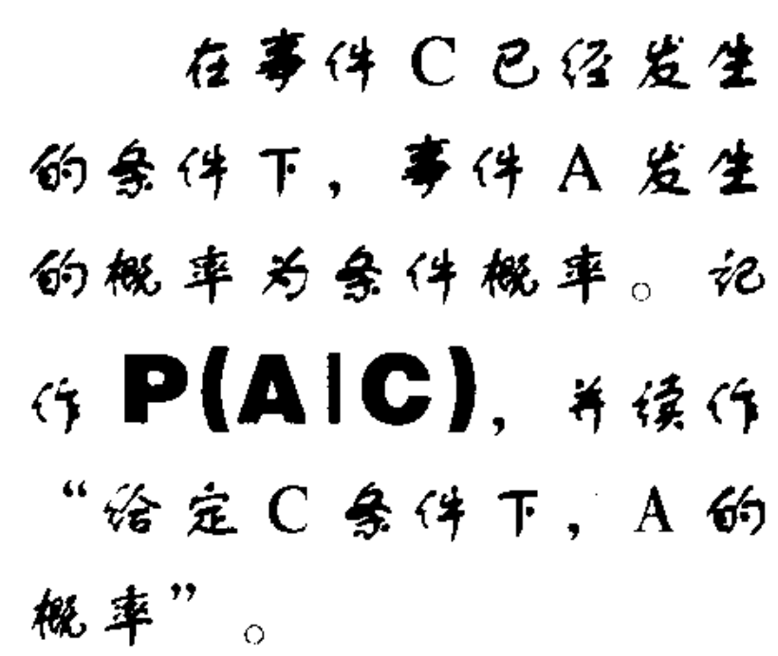
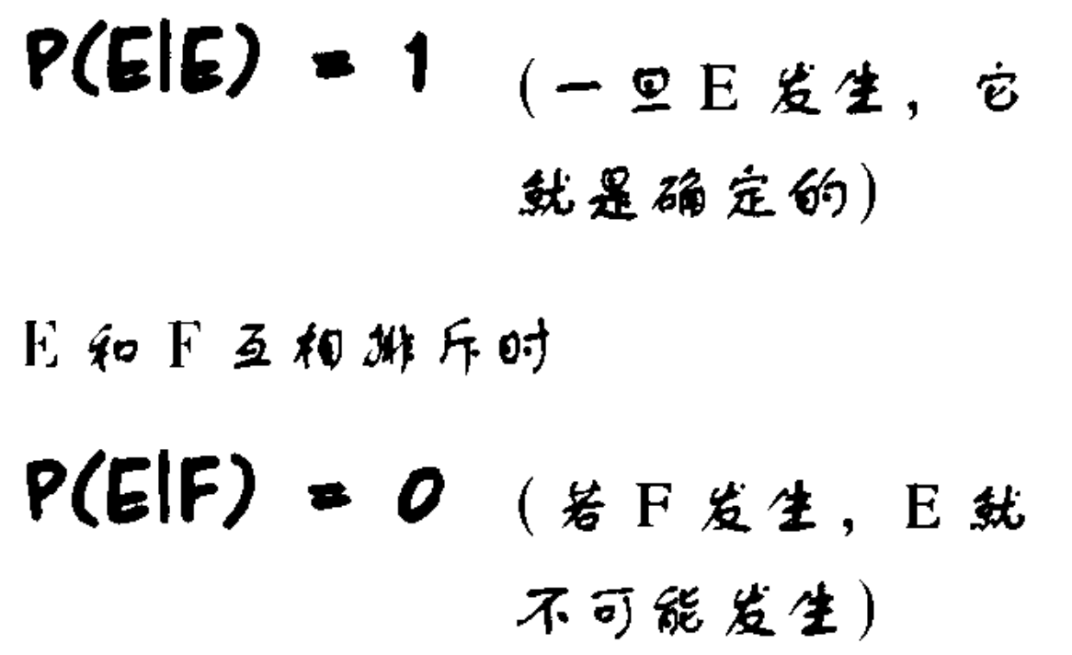
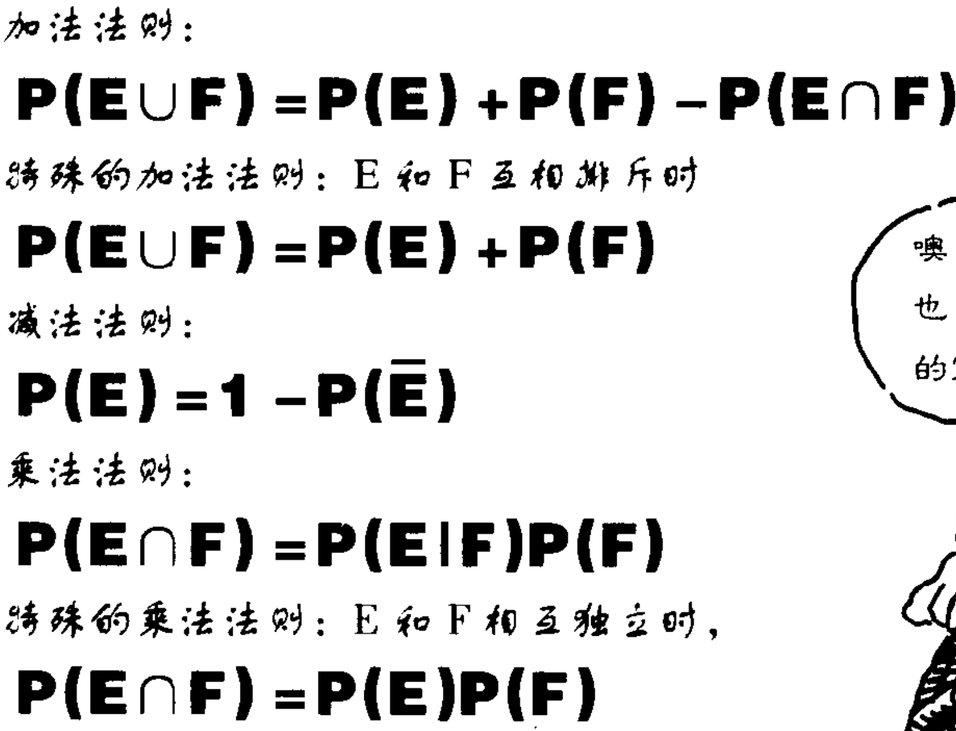

Slide 11

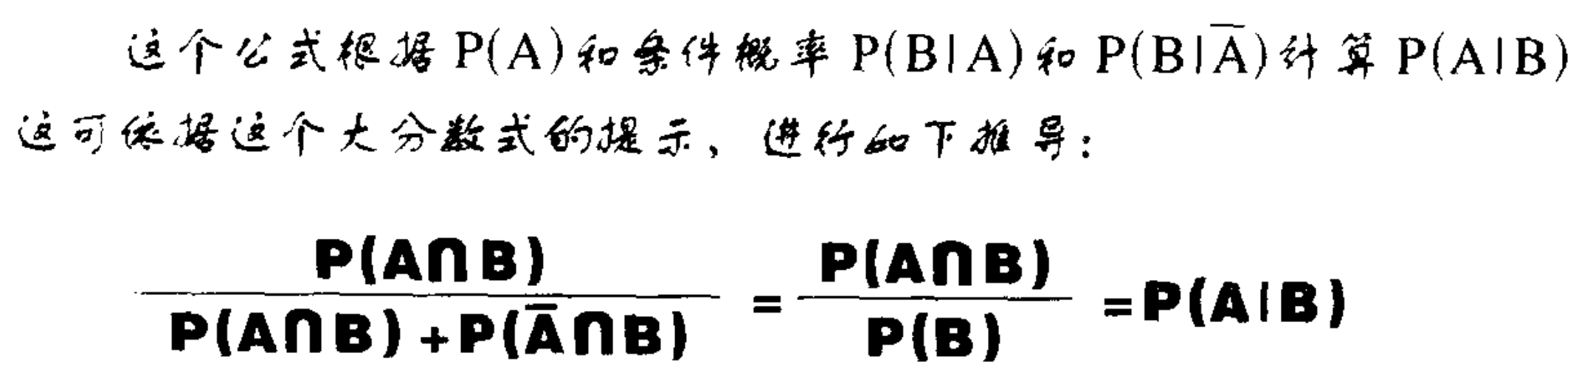

Slide 12
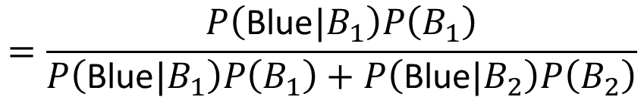
Two Boxes
Box 1
Box 2
P(B₁) = 2/3
P(B₂) = 1/3
P(Blue|B₁) = 4/5
P(Blue|B₂) = 2/5
P(Green|B₁) = 1/5
P(Green|B₂) = 3/5
from one of the boxes
Where does it come from?
$$=\frac{P\left(\text{Blue}|B_{1}\right)P\left(B_{1}\right)}{P\left(\text{Blue}|B_{1}\right)P\left(B_{1}\right)+P\left(\text{Blue}|B_{2}\right)P\left(B_{2}\right)}$$
P(B₁ | Blue)

Slide 13
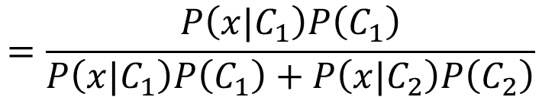

Two Classes
Estimating the Probabilities
From training data
Class 1
Class 2
P(C₁)
P(C₂)
P(x|C₁)
P(x|C₂)
Given an x, which class does it belong to
$$=\frac{P\left(x|C_{1}\right)P\left(C_{1}\right)}{P\left(x|C_{1}\right)P\left(C_{1}\right)+P\left(x|C_{2}\right)P\left(C_{2}\right)}$$
$$P\left(C_{1}|x\right)$$
Generative Model
$P\left(x\right)=P\left(x|C_{1}\right)P\left(C_{1}\right)+P\left(x|C_{2}\right)P\left(C_{2}\right)$ = $P\left(x∩C_{1}\right)+P\left(x∩C_{2}\right)$
Notes:
Classification: Probabilistic Generative Model 分类：概率生成模型
Credit Scoring 信用评分
Input: income, savings, profession, age, past financial history …… 输入：收入，储蓄，职业，年龄，过去的财务历史......
Output: accept or refuse 输出：accept或refuse
Medical Diagnosis 医学诊断
Input: current symptoms, age, gender, past medical history …… 输入：当前症状，年龄，性别，既往病史......
Output: which kind of diseases 输出：哪一类疾病
Handwritten character recognition 手写字符识别
Face recognition 人脸识别
Input: image of a face, output: person 输入：人脸图像，输出：人
Total: sum of all stats that come after this, a general guide to how strong a pokemon is 总值：在此之后的所有属性的总和，即关于pokemon的强大程度的一般指南
HP: hit points, or health, defines how much damage a pokemon can withstand before fainting HP：生命值或生命值决定了pokemon在昏厥前能够承受多少伤害
Attack: the base modifier for normal attacks (eg. Scratch, Punch) 攻击:普通攻击的基础修正值。划痕,打孔)
Defense: the base damage resistance against normal attacks 防御:抵抗普通攻击的基础伤害
SP Atk: special attack, the base modifier for special attacks (e.g. fire blast, bubble beam) SP攻击：特殊攻击，特殊攻击的基础修饰符（如火焰爆炸，气泡束）
SP Def: the base damage resistance against special attacks SP防御:对特殊攻击的基础伤害抵抗
Speed: determines which pokemon attacks first each round 速度：决定每个回合哪个口袋妖怪先攻击
Can we predict the “type” of pokemon based on the information? 我们能否根据这些信息预测pokemon的“类型”？
Ideal Alternatives 理想的替代品
Perceptron 感知器
Testing: closer to 1 $→$ class 1; closer to -1 $→$ class 2
接近 1 为第一类，接近 2 为第二类
to decrease error 为了减少误差
Penalize to the examples that are “too correct” … 惩罚那些“太正确”的例子……
Estimating the Probabilities From training data 从训练数据估计概率
Prior 先前的，事先的
Gaussian Distribution 高斯分布
Maximum Likelihood 最大似然

Slide 14
Prior
Class 1
Class 2
P(C₁)
P(C₂)
Water
Normal
Water and Normal type with ID < 400 for training, rest for testing
Training: 79 Water, 61 Normal
P(C₁) = 79 / (79 + 61) =0.56
P(C₂) = 61 / (79 + 61) =0.44
Notes:
Classification: Probabilistic Generative Model 分类：概率生成模型
Credit Scoring 信用评分
Input: income, savings, profession, age, past financial history …… 输入：收入，储蓄，职业，年龄，过去的财务历史......
Output: accept or refuse 输出：accept或refuse
Medical Diagnosis 医学诊断
Input: current symptoms, age, gender, past medical history …… 输入：当前症状，年龄，性别，既往病史......
Output: which kind of diseases 输出：哪一类疾病
Handwritten character recognition 手写字符识别
Face recognition 人脸识别
Input: image of a face, output: person 输入：人脸图像，输出：人
Total: sum of all stats that come after this, a general guide to how strong a pokemon is 总值：在此之后的所有属性的总和，即关于pokemon的强大程度的一般指南
HP: hit points, or health, defines how much damage a pokemon can withstand before fainting HP：生命值或生命值决定了pokemon在昏厥前能够承受多少伤害
Attack: the base modifier for normal attacks (eg. Scratch, Punch) 攻击:普通攻击的基础修正值。划痕,打孔)
Defense: the base damage resistance against normal attacks 防御:抵抗普通攻击的基础伤害
SP Atk: special attack, the base modifier for special attacks (e.g. fire blast, bubble beam) SP攻击：特殊攻击，特殊攻击的基础修饰符（如火焰爆炸，气泡束）
SP Def: the base damage resistance against special attacks SP防御:对特殊攻击的基础伤害抵抗
Speed: determines which pokemon attacks first each round 速度：决定每个回合哪个口袋妖怪先攻击
Can we predict the “type” of pokemon based on the information? 我们能否根据这些信息预测pokemon的“类型”？
Ideal Alternatives 理想的替代品
Perceptron 感知器
Testing: closer to 1 $→$ class 1; closer to -1 $→$ class 2
接近 1 为第一类，接近 2 为第二类
to decrease error 为了减少误差
Penalize to the examples that are “too correct” … 惩罚那些“太正确”的例子……
Estimating the Probabilities From training data 从训练数据估计概率
Prior 先前的，事先的
Gaussian Distribution 高斯分布
Maximum Likelihood 最大似然

Slide 15



Probability from Class
P(x|C₁) = ?
P( |Water)
= ?
Each Pokémon is represented as a vector by its attribute.
feature
79 in total
Water
Type
Notes:
Classification: Probabilistic Generative Model 分类：概率生成模型
Credit Scoring 信用评分
Input: income, savings, profession, age, past financial history …… 输入：收入，储蓄，职业，年龄，过去的财务历史......
Output: accept or refuse 输出：accept或refuse
Medical Diagnosis 医学诊断
Input: current symptoms, age, gender, past medical history …… 输入：当前症状，年龄，性别，既往病史......
Output: which kind of diseases 输出：哪一类疾病
Handwritten character recognition 手写字符识别
Face recognition 人脸识别
Input: image of a face, output: person 输入：人脸图像，输出：人
Total: sum of all stats that come after this, a general guide to how strong a pokemon is 总值：在此之后的所有属性的总和，即关于pokemon的强大程度的一般指南
HP: hit points, or health, defines how much damage a pokemon can withstand before fainting HP：生命值或生命值决定了pokemon在昏厥前能够承受多少伤害
Attack: the base modifier for normal attacks (eg. Scratch, Punch) 攻击:普通攻击的基础修正值。划痕,打孔)
Defense: the base damage resistance against normal attacks 防御:抵抗普通攻击的基础伤害
SP Atk: special attack, the base modifier for special attacks (e.g. fire blast, bubble beam) SP攻击：特殊攻击，特殊攻击的基础修饰符（如火焰爆炸，气泡束）
SP Def: the base damage resistance against special attacks SP防御:对特殊攻击的基础伤害抵抗
Speed: determines which pokemon attacks first each round 速度：决定每个回合哪个口袋妖怪先攻击
Can we predict the “type” of pokemon based on the information? 我们能否根据这些信息预测pokemon的“类型”？
Ideal Alternatives 理想的替代品
Perceptron 感知器
Testing: closer to 1 $→$ class 1; closer to -1 $→$ class 2
接近 1 为第一类，接近 2 为第二类
to decrease error 为了减少误差
Penalize to the examples that are “too correct” … 惩罚那些“太正确”的例子……
Estimating the Probabilities From training data 从训练数据估计概率
Prior 先前的，事先的
Gaussian Distribution 高斯分布
Maximum Likelihood 最大似然

Slide 16
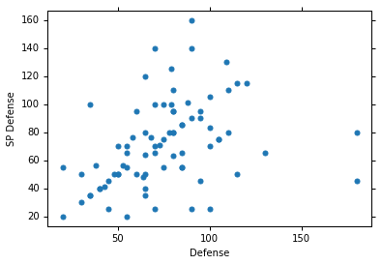


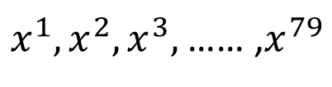

Probability from Class - Feature
Considering Defense and SP Defense
$$\left[\begin{aligned}48 \\ 50\end{aligned}\right]$$
$x^{1},x^{2},x^{3},$ …… ,$x^{79}$
$$\left[\begin{aligned}65 \\ 64\end{aligned}\right]$$
P(x|Water)=?
0?
Assume the points are sampled from a Gaussian distribution.
$$\left[\begin{aligned}103 \\ 45\end{aligned}\right]$$
Water
Type
Notes:
Classification: Probabilistic Generative Model 分类：概率生成模型
Credit Scoring 信用评分
Input: income, savings, profession, age, past financial history …… 输入：收入，储蓄，职业，年龄，过去的财务历史......
Output: accept or refuse 输出：accept或refuse
Medical Diagnosis 医学诊断
Input: current symptoms, age, gender, past medical history …… 输入：当前症状，年龄，性别，既往病史......
Output: which kind of diseases 输出：哪一类疾病
Handwritten character recognition 手写字符识别
Face recognition 人脸识别
Input: image of a face, output: person 输入：人脸图像，输出：人
Total: sum of all stats that come after this, a general guide to how strong a pokemon is 总值：在此之后的所有属性的总和，即关于pokemon的强大程度的一般指南
HP: hit points, or health, defines how much damage a pokemon can withstand before fainting HP：生命值或生命值决定了pokemon在昏厥前能够承受多少伤害
Attack: the base modifier for normal attacks (eg. Scratch, Punch) 攻击:普通攻击的基础修正值。划痕,打孔)
Defense: the base damage resistance against normal attacks 防御:抵抗普通攻击的基础伤害
SP Atk: special attack, the base modifier for special attacks (e.g. fire blast, bubble beam) SP攻击：特殊攻击，特殊攻击的基础修饰符（如火焰爆炸，气泡束）
SP Def: the base damage resistance against special attacks SP防御:对特殊攻击的基础伤害抵抗
Speed: determines which pokemon attacks first each round 速度：决定每个回合哪个口袋妖怪先攻击
Can we predict the “type” of pokemon based on the information? 我们能否根据这些信息预测pokemon的“类型”？
Ideal Alternatives 理想的替代品
Perceptron 感知器
Testing: closer to 1 $→$ class 1; closer to -1 $→$ class 2
接近 1 为第一类，接近 2 为第二类
to decrease error 为了减少误差
Penalize to the examples that are “too correct” … 惩罚那些“太正确”的例子……
Estimating the Probabilities From training data 从训练数据估计概率
Prior 先前的，事先的
Gaussian Distribution 高斯分布
Maximum Likelihood 最大似然

Slide 17
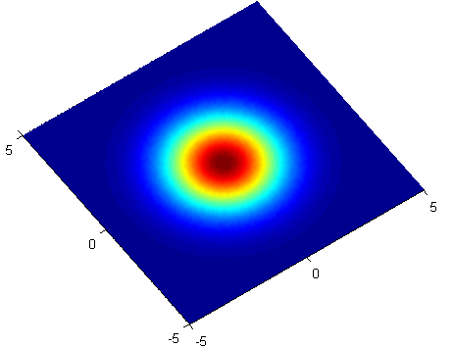
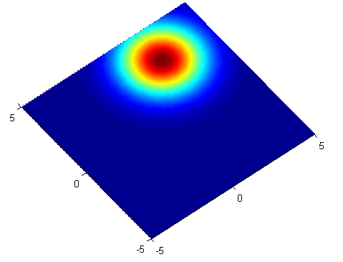


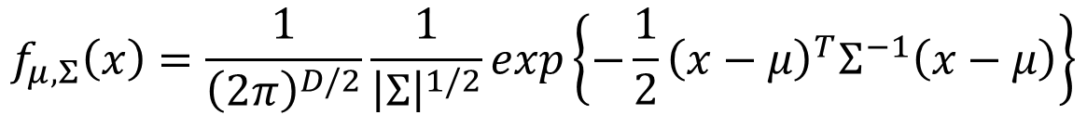

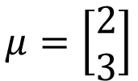
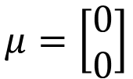

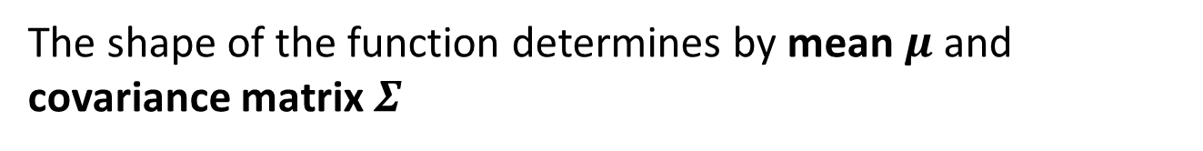


Gaussian Distribution
https://blog.slinuxer.com/tag/pca
$$f_{μ,Σ}\left(x\right)=\frac{1}{{\left(2π\right)}^{D/2}}\frac{1}{{\left|Σ\right|}^{1/2}}exp\left\{−\frac{1}{2}{\left(x−μ\right)}^{T}Σ^{−1}\left(x−μ\right)\right\}$$
Input: vector x, output: probability of sampling x
The shape of the function determines by mean $μ$ and covariance matrix $Σ$
$$μ=\left[\begin{aligned}0 \\ 0\end{aligned}\right]$$
$$\sum{=}\left[\begin{matrix}2 & 0 \\ 0 & 2\end{matrix}\right]$$
$$μ=\left[\begin{aligned}2 \\ 3\end{aligned}\right]$$
$$\sum{=}\left[\begin{matrix}2 & 0 \\ 0 & 2\end{matrix}\right]$$
$$x_{2}$$
$$x_{2}$$
$$x_{1}$$
$$x_{1}$$
Notes:
Classification: Probabilistic Generative Model 分类：概率生成模型
Credit Scoring 信用评分
Input: income, savings, profession, age, past financial history …… 输入：收入，储蓄，职业，年龄，过去的财务历史......
Output: accept or refuse 输出：accept或refuse
Medical Diagnosis 医学诊断
Input: current symptoms, age, gender, past medical history …… 输入：当前症状，年龄，性别，既往病史......
Output: which kind of diseases 输出：哪一类疾病
Handwritten character recognition 手写字符识别
Face recognition 人脸识别
Input: image of a face, output: person 输入：人脸图像，输出：人
Total: sum of all stats that come after this, a general guide to how strong a pokemon is 总值：在此之后的所有属性的总和，即关于pokemon的强大程度的一般指南
HP: hit points, or health, defines how much damage a pokemon can withstand before fainting HP：生命值或生命值决定了pokemon在昏厥前能够承受多少伤害
Attack: the base modifier for normal attacks (eg. Scratch, Punch) 攻击:普通攻击的基础修正值。划痕,打孔)
Defense: the base damage resistance against normal attacks 防御:抵抗普通攻击的基础伤害
SP Atk: special attack, the base modifier for special attacks (e.g. fire blast, bubble beam) SP攻击：特殊攻击，特殊攻击的基础修饰符（如火焰爆炸，气泡束）
SP Def: the base damage resistance against special attacks SP防御:对特殊攻击的基础伤害抵抗
Speed: determines which pokemon attacks first each round 速度：决定每个回合哪个口袋妖怪先攻击
Can we predict the “type” of pokemon based on the information? 我们能否根据这些信息预测pokemon的“类型”？
Ideal Alternatives 理想的替代品
Perceptron 感知器
Testing: closer to 1 $→$ class 1; closer to -1 $→$ class 2
接近 1 为第一类，接近 2 为第二类
to decrease error 为了减少误差
Penalize to the examples that are “too correct” … 惩罚那些“太正确”的例子……
Estimating the Probabilities From training data 从训练数据估计概率
Prior 先前的，事先的
Gaussian Distribution 高斯分布
Maximum Likelihood 最大似然

Slide 18
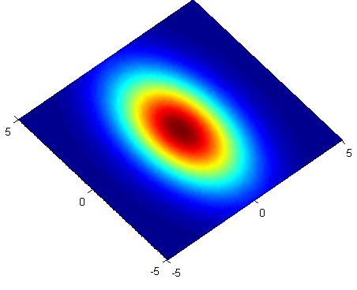
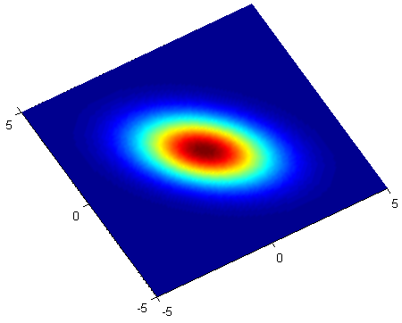


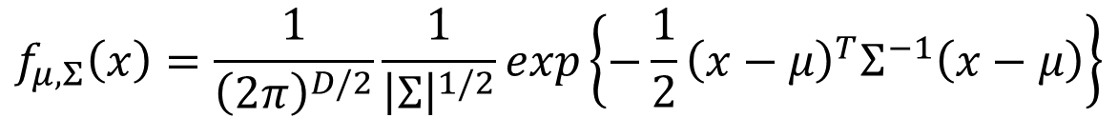

Gaussian Distribution
https://blog.slinuxer.com/tag/pca
$$f_{μ,Σ}\left(x\right)=\frac{1}{{\left(2π\right)}^{D/2}}\frac{1}{{\left|Σ\right|}^{1/2}}exp\left\{−\frac{1}{2}{\left(x−μ\right)}^{T}Σ^{−1}\left(x−μ\right)\right\}$$
Input: vector x, output: probability of sampling x
The shape of the function determines by mean $μ$ and covariance matrix $Σ$
$$μ=\left[\begin{aligned}0 \\ 0\end{aligned}\right]$$
$$\sum{=}\left[\begin{matrix}2 & 0 \\ 0 & 6\end{matrix}\right]$$
$$μ=\left[\begin{aligned}0 \\ 0\end{aligned}\right]$$
$$\sum{=}\left[\begin{matrix}2 & −1 \\ −1 & 2\end{matrix}\right]$$
$$x_{2}$$
$$x_{2}$$
$$x_{1}$$
$$x_{1}$$
Notes:
Classification: Probabilistic Generative Model 分类：概率生成模型
Credit Scoring 信用评分
Input: income, savings, profession, age, past financial history …… 输入：收入，储蓄，职业，年龄，过去的财务历史......
Output: accept or refuse 输出：accept或refuse
Medical Diagnosis 医学诊断
Input: current symptoms, age, gender, past medical history …… 输入：当前症状，年龄，性别，既往病史......
Output: which kind of diseases 输出：哪一类疾病
Handwritten character recognition 手写字符识别
Face recognition 人脸识别
Input: image of a face, output: person 输入：人脸图像，输出：人
Total: sum of all stats that come after this, a general guide to how strong a pokemon is 总值：在此之后的所有属性的总和，即关于pokemon的强大程度的一般指南
HP: hit points, or health, defines how much damage a pokemon can withstand before fainting HP：生命值或生命值决定了pokemon在昏厥前能够承受多少伤害
Attack: the base modifier for normal attacks (eg. Scratch, Punch) 攻击:普通攻击的基础修正值。划痕,打孔)
Defense: the base damage resistance against normal attacks 防御:抵抗普通攻击的基础伤害
SP Atk: special attack, the base modifier for special attacks (e.g. fire blast, bubble beam) SP攻击：特殊攻击，特殊攻击的基础修饰符（如火焰爆炸，气泡束）
SP Def: the base damage resistance against special attacks SP防御:对特殊攻击的基础伤害抵抗
Speed: determines which pokemon attacks first each round 速度：决定每个回合哪个口袋妖怪先攻击
Can we predict the “type” of pokemon based on the information? 我们能否根据这些信息预测pokemon的“类型”？
Ideal Alternatives 理想的替代品
Perceptron 感知器
Testing: closer to 1 $→$ class 1; closer to -1 $→$ class 2
接近 1 为第一类，接近 2 为第二类
to decrease error 为了减少误差
Penalize to the examples that are “too correct” … 惩罚那些“太正确”的例子……
Estimating the Probabilities From training data 从训练数据估计概率
Prior 先前的，事先的
Gaussian Distribution 高斯分布
Ref: https://www.cs.cmu.edu/~epxing/Class/10701-08s/recitation/gaussian.pdf
Maximum Likelihood 最大似然

Slide 19

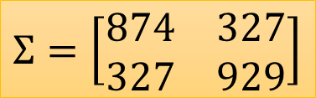

Probability from Class
Assume the points are sampled from a Gaussian distribution
Find the Gaussian distribution behind them
Probability for new points
$x^{1},x^{2},x^{3},$ …… ,$x^{79}$
New x
$$μ=\left[\begin{aligned}75.0 \\ 71.3\end{aligned}\right]$$
$$Σ=\left[\begin{matrix}874 & 327 \\ 327 & 929\end{matrix}\right]$$
How to find them?
Water
Type
$$f_{μ,Σ}\left(x\right)=\frac{1}{{\left(2π\right)}^{D/2}}\frac{1}{{\left|Σ\right|}^{1/2}}exp\left\{−\frac{1}{2}{\left(x−μ\right)}^{T}Σ^{−1}\left(x−μ\right)\right\}$$

Slide 20
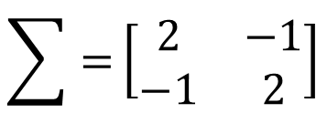
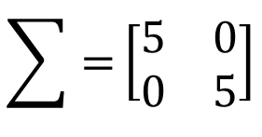
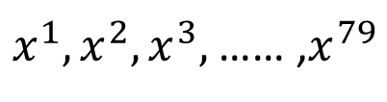
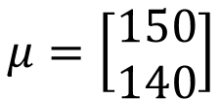

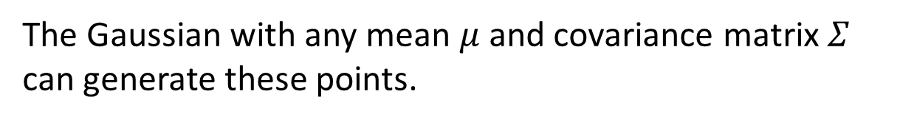
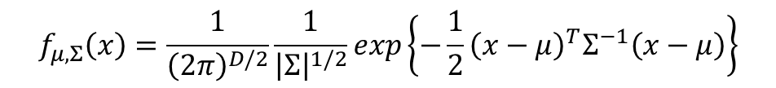

Maximum Likelihood
$$f_{μ,Σ}\left(x\right)=\frac{1}{{\left(2π\right)}^{D/2}}\frac{1}{{\left|Σ\right|}^{1/2}}exp\left\{−\frac{1}{2}{\left(x−μ\right)}^{T}Σ^{−1}\left(x−μ\right)\right\}$$
$$\sum{=}\left[\begin{matrix}5 & 0 \\ 0 & 5\end{matrix}\right]$$
$x^{1},x^{2},x^{3},$ …… ,$x^{79}$
$$μ=\left[\begin{aligned}150 \\ 140\end{aligned}\right]$$
$$\sum{=}\left[\begin{matrix}2 & −1 \\ −1 & 2\end{matrix}\right]$$
$$μ=\left[\begin{aligned}75 \\ 75\end{aligned}\right]$$
The Gaussian with any mean $μ$ and covariance matrix $Σ$ can generate these points.
Different Likelihood
Likelihood of a Gaussian with mean $μ$ and covariance matrix $Σ$
= the probability of the Gaussian samples $x^{1},x^{2},x^{3},$ …… ,$x^{79}$
$$L\left(μ,Σ\right)$$
$$=f_{μ,Σ}\left(x^{1}\right)f_{μ,Σ}\left(x^{2}\right)f_{μ,Σ}\left(x^{3}\right)……f_{μ,Σ}\left(x^{79}\right)$$
Notes:
Classification: Probabilistic Generative Model 分类：概率生成模型
Credit Scoring 信用评分
Input: income, savings, profession, age, past financial history …… 输入：收入，储蓄，职业，年龄，过去的财务历史......
Output: accept or refuse 输出：accept或refuse
Medical Diagnosis 医学诊断
Input: current symptoms, age, gender, past medical history …… 输入：当前症状，年龄，性别，既往病史......
Output: which kind of diseases 输出：哪一类疾病
Handwritten character recognition 手写字符识别
Face recognition 人脸识别
Input: image of a face, output: person 输入：人脸图像，输出：人
Total: sum of all stats that come after this, a general guide to how strong a pokemon is 总值：在此之后的所有属性的总和，即关于pokemon的强大程度的一般指南
HP: hit points, or health, defines how much damage a pokemon can withstand before fainting HP：生命值或生命值决定了pokemon在昏厥前能够承受多少伤害
Attack: the base modifier for normal attacks (eg. Scratch, Punch) 攻击:普通攻击的基础修正值。划痕,打孔)
Defense: the base damage resistance against normal attacks 防御:抵抗普通攻击的基础伤害
SP Atk: special attack, the base modifier for special attacks (e.g. fire blast, bubble beam) SP攻击：特殊攻击，特殊攻击的基础修饰符（如火焰爆炸，气泡束）
SP Def: the base damage resistance against special attacks SP防御:对特殊攻击的基础伤害抵抗
Speed: determines which pokemon attacks first each round 速度：决定每个回合哪个口袋妖怪先攻击
Can we predict the “type” of pokemon based on the information? 我们能否根据这些信息预测pokemon的“类型”？
Ideal Alternatives 理想的替代品
Perceptron 感知器
Testing: closer to 1 $→$ class 1; closer to -1 $→$ class 2
接近 1 为第一类，接近 2 为第二类
to decrease error 为了减少误差
Penalize to the examples that are “too correct” … 惩罚那些“太正确”的例子……
Estimating the Probabilities From training data 从训练数据估计概率
Prior 先前的，事先的
Gaussian Distribution 高斯分布
Ref: https://www.cs.cmu.edu/~epxing/Class/10701-08s/recitation/gaussian.pdf
Maximum Likelihood 最大似然

Slide 21
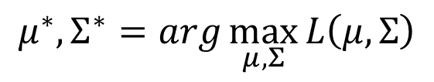



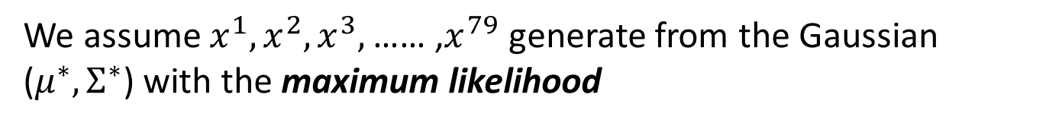
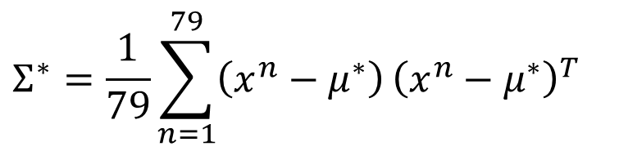
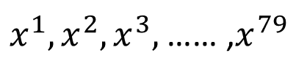
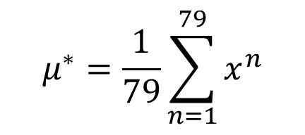
Maximum Likelihood
We have the “Water” type Pokémons:
$x^{1},x^{2},x^{3},$ …… ,$x^{79}$
We assume $x^{1},x^{2},x^{3},$ …… ,$x^{79}$ generate from the Gaussian ($μ^{∗},Σ^{∗}$) with the maximum likelihood
$$L\left(μ,Σ\right)$$
$$=f_{μ,Σ}\left(x^{1}\right)f_{μ,Σ}\left(x^{2}\right)f_{μ,Σ}\left(x^{3}\right)……f_{μ,Σ}\left(x^{79}\right)$$
$$f_{μ,Σ}\left(x\right)=\frac{1}{{\left(2π\right)}^{D/2}}\frac{1}{{\left|Σ\right|}^{1/2}}exp\left\{−\frac{1}{2}{\left(x−μ\right)}^{T}Σ^{−1}\left(x−μ\right)\right\}$$
$$μ^{∗},Σ^{∗}=arg\max_{μ,Σ}{L\left(μ,Σ\right)}$$
$$μ^{∗}=\frac{1}{79}\sum_{n=1}^{79}{x^{n}}$$
$$Σ^{∗}=\frac{1}{79}\sum_{n=1}^{79}{\left(x^{n}−μ^{∗}\right)}{\left(x^{n}−μ^{∗}\right)}^{T}$$
average
Notes:
Classification: Probabilistic Generative Model 分类：概率生成模型
Credit Scoring 信用评分
Input: income, savings, profession, age, past financial history …… 输入：收入，储蓄，职业，年龄，过去的财务历史......
Output: accept or refuse 输出：accept或refuse
Medical Diagnosis 医学诊断
Input: current symptoms, age, gender, past medical history …… 输入：当前症状，年龄，性别，既往病史......
Output: which kind of diseases 输出：哪一类疾病
Handwritten character recognition 手写字符识别
Face recognition 人脸识别
Input: image of a face, output: person 输入：人脸图像，输出：人
Total: sum of all stats that come after this, a general guide to how strong a pokemon is 总值：在此之后的所有属性的总和，即关于pokemon的强大程度的一般指南
HP: hit points, or health, defines how much damage a pokemon can withstand before fainting HP：生命值或生命值决定了pokemon在昏厥前能够承受多少伤害
Attack: the base modifier for normal attacks (eg. Scratch, Punch) 攻击:普通攻击的基础修正值。划痕,打孔)
Defense: the base damage resistance against normal attacks 防御:抵抗普通攻击的基础伤害
SP Atk: special attack, the base modifier for special attacks (e.g. fire blast, bubble beam) SP攻击：特殊攻击，特殊攻击的基础修饰符（如火焰爆炸，气泡束）
SP Def: the base damage resistance against special attacks SP防御:对特殊攻击的基础伤害抵抗
Speed: determines which pokemon attacks first each round 速度：决定每个回合哪个口袋妖怪先攻击
Can we predict the “type” of pokemon based on the information? 我们能否根据这些信息预测pokemon的“类型”？
Ideal Alternatives 理想的替代品
Perceptron 感知器
Testing: closer to 1 $→$ class 1; closer to -1 $→$ class 2
接近 1 为第一类，接近 2 为第二类
to decrease error 为了减少误差
Penalize to the examples that are “too correct” … 惩罚那些“太正确”的例子……
Estimating the Probabilities From training data 从训练数据估计概率
Prior 先前的，事先的
Gaussian Distribution 高斯分布
Ref: https://www.cs.cmu.edu/~epxing/Class/10701-08s/recitation/gaussian.pdf
Maximum Likelihood 最大似然

Slide 22
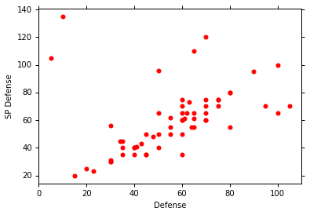
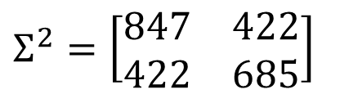
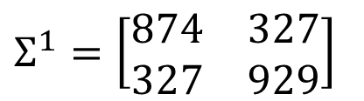
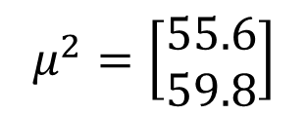

Maximum Likelihood
Class 1: Water
Class 2: Normal
$$μ^{1}=\left[\begin{aligned}75.0 \\ 71.3\end{aligned}\right]$$
$$Σ^{1}=\left[\begin{matrix}874 & 327 \\ 327 & 929\end{matrix}\right]$$
$$μ^{2}=\left[\begin{aligned}55.6 \\ 59.8\end{aligned}\right]$$
$$Σ^{2}=\left[\begin{matrix}847 & 422 \\ 422 & 685\end{matrix}\right]$$
Notes:
Classification: Probabilistic Generative Model 分类：概率生成模型
Credit Scoring 信用评分
Input: income, savings, profession, age, past financial history …… 输入：收入，储蓄，职业，年龄，过去的财务历史......
Output: accept or refuse 输出：accept或refuse
Medical Diagnosis 医学诊断
Input: current symptoms, age, gender, past medical history …… 输入：当前症状，年龄，性别，既往病史......
Output: which kind of diseases 输出：哪一类疾病
Handwritten character recognition 手写字符识别
Face recognition 人脸识别
Input: image of a face, output: person 输入：人脸图像，输出：人
Total: sum of all stats that come after this, a general guide to how strong a pokemon is 总值：在此之后的所有属性的总和，即关于pokemon的强大程度的一般指南
HP: hit points, or health, defines how much damage a pokemon can withstand before fainting HP：生命值或生命值决定了pokemon在昏厥前能够承受多少伤害
Attack: the base modifier for normal attacks (eg. Scratch, Punch) 攻击:普通攻击的基础修正值。划痕,打孔)
Defense: the base damage resistance against normal attacks 防御:抵抗普通攻击的基础伤害
SP Atk: special attack, the base modifier for special attacks (e.g. fire blast, bubble beam) SP攻击：特殊攻击，特殊攻击的基础修饰符（如火焰爆炸，气泡束）
SP Def: the base damage resistance against special attacks SP防御:对特殊攻击的基础伤害抵抗
Speed: determines which pokemon attacks first each round 速度：决定每个回合哪个口袋妖怪先攻击
Can we predict the “type” of pokemon based on the information? 我们能否根据这些信息预测pokemon的“类型”？
Ideal Alternatives 理想的替代品
Perceptron 感知器
Testing: closer to 1 $→$ class 1; closer to -1 $→$ class 2
接近 1 为第一类，接近 2 为第二类
to decrease error 为了减少误差
Penalize to the examples that are “too correct” … 惩罚那些“太正确”的例子……
Estimating the Probabilities From training data 从训练数据估计概率
Prior 先前的，事先的
Gaussian Distribution 高斯分布
Ref: https://www.cs.cmu.edu/~epxing/Class/10701-08s/recitation/gaussian.pdf
Maximum Likelihood 最大似然

Slide 23







Now we can do classification ☺
$$f_{μ^{1},Σ^{1}}\left(x\right)=\frac{1}{{\left(2π\right)}^{D/2}}\frac{1}{{\left|Σ^{1}\right|}^{1/2}}exp\left\{−\frac{1}{2}{\left(x−μ^{1}\right)}^{T}{\left(Σ^{1}\right)}^{−1}\left(x−μ^{1}\right)\right\}$$
P(C1)
= 79 / (79 + 61) =0.56
$$μ^{1}=\left[\begin{aligned}75.0 \\ 71.3\end{aligned}\right]$$
$$Σ^{1}=\left[\begin{matrix}874 & 327 \\ 327 & 929\end{matrix}\right]$$
$$=\frac{P\left(x|C_{1}\right)P\left(C_{1}\right)}{P\left(x|C_{1}\right)P\left(C_{1}\right)+P\left(x|C_{2}\right)P\left(C_{2}\right)}$$
$$P\left(C_{1}|x\right)$$
$$f_{μ^{2},Σ^{2}}\left(x\right)=\frac{1}{{\left(2π\right)}^{D/2}}\frac{1}{{\left|Σ^{2}\right|}^{1/2}}exp\left\{−\frac{1}{2}{\left(x−μ^{2}\right)}^{T}{\left(Σ^{2}\right)}^{−1}\left(x−μ^{2}\right)\right\}$$
P(C2)
= 61 / (79 + 61)
=0.44
$$μ^{2}=\left[\begin{aligned}55.6 \\ 59.8\end{aligned}\right]$$
$$Σ^{2}=\left[\begin{matrix}847 & 422 \\ 422 & 685\end{matrix}\right]$$
If $P\left(C_{1}|x\right)>0.5$
x belongs to class 1 (Water)

Slide 24










$$P\left(C_{1}|x\right)$$
$$>0.5$$
$$P\left(C_{1}|x\right)$$
$$P\left(C_{1}|x\right)<0.5$$
Blue points: C₁ (Water), Red points: C₂ (Normal)
How’s the results?
$$P\left(C_{1}|x\right)$$
$$>0.5$$
Testing data: 47% accuracy ☹
All: hp, att, sp att,
de, sp de, speed (6 features)
$μ^{1},μ^{2}:$ 6-dim vector
$Σ^{1},Σ^{2}:$ 6 x 6 matrices
$$P\left(C_{1}|x\right)<0.5$$
64% accuracy …

Slide 25





Modifying Model
Class 1: Water
Class 2: Normal
$$μ^{1}=\left[\begin{aligned}75.0 \\ 71.3\end{aligned}\right]$$
$$Σ^{1}=\left[\begin{matrix}874 & 327 \\ 327 & 929\end{matrix}\right]$$
$$μ^{2}=\left[\begin{aligned}55.6 \\ 59.8\end{aligned}\right]$$
$$Σ^{2}=\left[\begin{matrix}847 & 422 \\ 422 & 685\end{matrix}\right]$$
The same $Σ$
Less parameters

Slide 26








Modifying Model
Ref: Bishop, chapter 4.2.2
Maximum likelihood
“Water” type Pokémons:
“Normal” type Pokémons:
$x^{1},x^{2},x^{3},$ …… ,$x^{79}$
$x^{80},x^{81},x^{82},$ …… ,$x^{140}$
$$μ^{1}$$
$Σ$
$$μ^{2}$$
Find $μ^{1}$, $μ^{2}$, $Σ$ maximizing the likelihood $L\left(μ^{1}\text{,}μ^{2}\text{,}Σ\right)$
$$L\left(μ^{1}\text{,}μ^{2}\text{,}Σ\right)=f_{μ^{1},Σ}\left(x^{1}\right)f_{μ^{1},Σ}\left(x^{2}\right)⋯f_{μ^{1},Σ}\left(x^{79}\right)$$
$$×f_{μ^{2},Σ}\left(x^{80}\right)f_{μ^{2},Σ}\left(x^{81}\right)⋯f_{μ^{2},Σ}\left(x^{140}\right)$$
$μ^{1}$ and $μ^{2}$ is the same
$Σ=\frac{79}{140}Σ^{1}+\frac{61}{140}Σ^{2}$

Slide 27

Modifying Model
The boundary is linear
The same covariance matrix
All: hp, att, sp att, de, sp de, speed
54% accuracy
73% accuracy
Notes:
Indenty: 50% accuracy
Share diagonal
: 56%
Indenty: 54%
Not Shared diagonal

Slide 28




Three Steps
Function Set (Model):
Goodness of a function:
The mean $μ$ and covariance $Σ$ that maximizing the likelihood (the probability of generating data)
Find the best function: easy
$$P\left(C_{1}|x\right)=\frac{P\left(x|C_{1}\right)P\left(C_{1}\right)}{P\left(x|C_{1}\right)P\left(C_{1}\right)+P\left(x|C_{2}\right)P\left(C_{2}\right)}$$
$$x$$
If $P\left(C_{1}|x\right)>0.5$, output: class 1
Otherwise, output: class 2

Slide 29





Probability Distribution
You can always use the distribution you like ☺
$$P\left(x|C_{1}\right)$$
$$=P\left(x_{1}|C_{1}\right)$$
$$P\left(x_{2}|C_{1}\right)$$
……
$$P\left(x_{k}|C_{1}\right)$$
……
$$\left[\begin{aligned}x_{1} \\ x_{2} \\ ⋮ \\ x_{k} \\ ⋮ \\ x_{K}\end{aligned}\right]$$
1-D Gaussian
For binary features, you may assume they are from Bernoulli distributions.
If you assume all the dimensions are independent, then you are using Naive Bayes Classifier.

Slide 30






Posterior Probability
$$P\left(C_{1}|x\right)=\frac{P\left(x|C_{1}\right)P\left(C_{1}\right)}{P\left(x|C_{1}\right)P\left(C_{1}\right)+P\left(x|C_{2}\right)P\left(C_{2}\right)}$$
$$=\frac{1}{1+\frac{P\left(x|C_{2}\right)P\left(C_{2}\right)}{P\left(x|C_{1}\right)P\left(C_{1}\right)}}$$
$$=\frac{1}{1+exp\left(−z\right)}$$
$$=σ\left(z\right)$$
Sigmoid function
$$z=ln\frac{P\left(x|C_{1}\right)P\left(C_{1}\right)}{P\left(x|C_{2}\right)P\left(C_{2}\right)}$$

Slide 31
Warning of Math

Slide 32






Posterior Probability
$$z=ln\frac{P\left(x|C_{1}\right)P\left(C_{1}\right)}{P\left(x|C_{2}\right)P\left(C_{2}\right)}$$
$$P\left(C_{1}|x\right)$$
$$=σ\left(z\right)$$
sigmoid
$$\frac{\frac{N_{1}}{N_{1}+N_{2}}}{\frac{N_{2}}{N_{1}+N_{2}}}$$
$$z=ln\frac{P\left(x|C_{1}\right)}{P\left(x|C_{2}\right)}+ln\frac{P\left(C_{1}\right)}{P\left(C_{2}\right)}$$
$$=\frac{N_{1}}{N_{2}}$$
$$P\left(x|C_{1}\right)=\frac{1}{{\left(2π\right)}^{D/2}}\frac{1}{{\left|Σ^{1}\right|}^{1/2}}exp\left\{−\frac{1}{2}{\left(x−μ^{1}\right)}^{T}{\left(Σ^{1}\right)}^{−1}\left(x−μ^{1}\right)\right\}$$
$$P\left(x|C_{2}\right)=\frac{1}{{\left(2π\right)}^{D/2}}\frac{1}{{\left|Σ^{2}\right|}^{1/2}}exp\left\{−\frac{1}{2}{\left(x−μ^{2}\right)}^{T}{\left(Σ^{2}\right)}^{−1}\left(x−μ^{2}\right)\right\}$$

Slide 33




$$z=ln\frac{P\left(x|C_{1}\right)}{P\left(x|C_{2}\right)}+ln\frac{P\left(C_{1}\right)}{P\left(C_{2}\right)}$$
$$=\frac{N_{1}}{N_{2}}$$
$$P\left(x|C_{1}\right)=\frac{1}{{\left(2π\right)}^{D/2}}\frac{1}{{\left|Σ^{1}\right|}^{1/2}}exp\left\{−\frac{1}{2}{\left(x−μ^{1}\right)}^{T}{\left(Σ^{1}\right)}^{−1}\left(x−μ^{1}\right)\right\}$$
$$P\left(x|C_{2}\right)=\frac{1}{{\left(2π\right)}^{D/2}}\frac{1}{{\left|Σ^{2}\right|}^{1/2}}exp\left\{−\frac{1}{2}{\left(x−μ^{2}\right)}^{T}{\left(Σ^{2}\right)}^{−1}\left(x−μ^{2}\right)\right\}$$
$$ln\frac{\frac{1}{{\left(2π\right)}^{D/2}}\frac{1}{{\left|Σ^{1}\right|}^{1/2}}exp\left\{−\frac{1}{2}{\left(x−μ^{1}\right)}^{T}{\left(Σ^{1}\right)}^{−1}\left(x−μ^{1}\right)\right\}}{\frac{1}{{\left(2π\right)}^{D/2}}\frac{1}{{\left|Σ^{2}\right|}^{1/2}}exp\left\{−\frac{1}{2}{\left(x−μ^{2}\right)}^{T}{\left(Σ^{2}\right)}^{−1}\left(x−μ^{2}\right)\right\}}$$
$$=ln\frac{{\left|Σ^{2}\right|}^{1/2}}{{\left|Σ^{1}\right|}^{1/2}}exp\left\{−\frac{1}{2}\left[{\left(x−μ^{1}\right)}^{T}{\left(Σ^{1}\right)}^{−1}\left(x−μ^{1}\right)−{\left(x−μ^{2}\right)}^{T}{\left(Σ^{2}\right)}^{−1}\left(x−μ^{2}\right)\right]\right\}$$
$$=ln\frac{{\left|Σ^{2}\right|}^{1/2}}{{\left|Σ^{1}\right|}^{1/2}}−\frac{1}{2}\left[{\left(x−μ^{1}\right)}^{T}{\left(Σ^{1}\right)}^{−1}\left(x−μ^{1}\right)−{\left(x−μ^{2}\right)}^{T}{\left(Σ^{2}\right)}^{−1}\left(x−μ^{2}\right)\right]$$

Slide 34






$$z=ln\frac{P\left(x|C_{1}\right)}{P\left(x|C_{2}\right)}+ln\frac{P\left(C_{1}\right)}{P\left(C_{2}\right)}$$
$$=\frac{N_{1}}{N_{2}}$$
$$=ln\frac{{\left|Σ^{2}\right|}^{1/2}}{{\left|Σ^{1}\right|}^{1/2}}−\frac{1}{2}\left[{\left(x−μ^{1}\right)}^{T}{\left(Σ^{1}\right)}^{−1}\left(x−μ^{1}\right)−{\left(x−μ^{2}\right)}^{T}{\left(Σ^{2}\right)}^{−1}\left(x−μ^{2}\right)\right]$$
$${\left(x−μ^{1}\right)}^{T}{\left(Σ^{1}\right)}^{−1}\left(x−μ^{1}\right)$$
$=x^{T}{\left(Σ^{1}\right)}^{−1}x−x^{T}{\left(Σ^{1}\right)}^{−1}μ^{1}−{\left(μ^{1}\right)}^{T}{\left(Σ^{1}\right)}^{−1}x$ $+{\left(μ^{1}\right)}^{T}{\left(Σ^{1}\right)}^{−1}μ^{1}$
$$=x^{T}{\left(Σ^{1}\right)}^{−1}x−2{\left(μ^{1}\right)}^{T}{\left(Σ^{1}\right)}^{−1}x+{\left(μ^{1}\right)}^{T}{\left(Σ^{1}\right)}^{−1}μ^{1}$$
$${\left(x−μ^{2}\right)}^{T}{\left(Σ^{2}\right)}^{−1}\left(x−μ^{2}\right)$$
$$=x^{T}{\left(Σ^{2}\right)}^{−1}x−2{\left(μ^{2}\right)}^{T}{\left(Σ^{2}\right)}^{−1}x+{\left(μ^{2}\right)}^{T}{\left(Σ^{2}\right)}^{−1}μ^{2}$$
$$z=ln\frac{{\left|Σ^{2}\right|}^{1/2}}{{\left|Σ^{1}\right|}^{1/2}}$$
$$−\frac{1}{2}x^{T}{\left(Σ^{1}\right)}^{−1}x+{\left(μ^{1}\right)}^{T}{\left(Σ^{1}\right)}^{−1}x−\frac{1}{2}{\left(μ^{1}\right)}^{T}{\left(Σ^{1}\right)}^{−1}μ^{1}$$
$$+\frac{1}{2}x^{T}{\left(Σ^{2}\right)}^{−1}x−{\left(μ^{2}\right)}^{T}{\left(Σ^{2}\right)}^{−1}x+\frac{1}{2}{\left(μ^{2}\right)}^{T}{\left(Σ^{2}\right)}^{−1}μ^{2}$$
$$+ln\frac{N_{1}}{N_{2}}$$

Slide 35
End of Warning

Slide 36










$$P\left(C_{1}|x\right)$$
$$=σ\left(z\right)$$
$$z=ln\frac{{\left|Σ^{2}\right|}^{1/2}}{{\left|Σ^{1}\right|}^{1/2}}$$
$$−\frac{1}{2}x^{T}{\left(Σ^{1}\right)}^{−1}x+{\left(μ^{1}\right)}^{T}{\left(Σ^{1}\right)}^{−1}x−\frac{1}{2}{\left(μ^{1}\right)}^{T}{\left(Σ^{1}\right)}^{−1}μ^{1}$$
$$+\frac{1}{2}x^{T}{\left(Σ^{2}\right)}^{−1}x−{\left(μ^{2}\right)}^{T}{\left(Σ^{2}\right)}^{−1}x+\frac{1}{2}{\left(μ^{2}\right)}^{T}{\left(Σ^{2}\right)}^{−1}μ^{2}$$
$$+ln\frac{N_{1}}{N_{2}}$$
$$Σ_{1}=Σ_{2}=Σ$$
$$z={\left(μ^{1}−μ^{2}\right)}^{T}Σ^{−1}x−\frac{1}{2}{\left(μ^{1}\right)}^{T}Σ^{−1}μ^{1}+\frac{1}{2}{\left(μ^{2}\right)}^{T}Σ^{−1}μ^{2}+ln\frac{N_{1}}{N_{2}}$$
$$w^{T}$$
$$b$$
$$P\left(C_{1}|x\right)=σ\left(w∙x+b\right)$$
How about directly find w and b?
In generative model, we estimate $N_{1},$ $N_{2}$, $μ^{1}$, $μ^{2}$, $Σ$
Then we have w and b

Slide 37
Reference
Bishop: Chapter 4.1 – 4.2
Data: https://www.kaggle.com/abcsds/pokemon
Useful posts:
https://www.kaggle.com/nishantbhadauria/d/abcsds/pokemon/pokemon-speed-attack-hp-defense-analysis-by-type
https://www.kaggle.com/nikos90/d/abcsds/pokemon/mastering-pokebars/discussion
https://www.kaggle.com/ndrewgele/d/abcsds/pokemon/visualizing-pok-mon-stats-with-seaborn/discussion

Slide 38
Acknowledgment
感謝 江貫榮 同學發現課程網頁上的日期錯誤
感謝 范廷瀚 同學提供寶可夢的 domain knowledge
感謝 Victor Chen 發現投影片上的打字錯誤

